Slide 1


Data Visualization of Bird Strikes between 2000 – 2011
Presented By: Md Sahil
Date: 20-04-2023

Slide 2
Objective:
Build a dashboard to analyze Bird Strikes between 2000 – 2011 in the US for aircraft safety and wildlife safety.
Benefits:
Depicting the Number of Bird Strikes.
Cost and damage analysis due to Bird Strikes.
To understand when most bird strikes occur.
Effect of Bird Strikes.
Analyzing wildlife species that are most often struck.
Try to find out patterns between aircraft type and bird strike.

Slide 3
Data Sharing Agreement:
File Name: Bird Strikes_Final.xlsx
File Type: Microsoft Excel Worksheet (.xlsx)
File Size: 3.74 MB
Number of rows: 25,559
Number of columns: 26
Dataset provider: Ineuron.ai team

Slide 4
Data Attributes (Part–1):
1) Record ID – Unique ID of each strike case record
2) Aircraft: Type – Type of the Aircraft
3) Airport: Name – Name of the Airport
4) Altitude bin – Contain Altitude values in respect of 2 bins which are < 1000 ft and > 1000 ft
5) Aircraft: Make/Model – Contain the model of Aircraft
6) Wildlife: Number struck – Contain number of wildlife struck in terms of 4 groups which
are 1, 2-10, 11-100, over 100
7) Wildlife: Number Struck Actual – Contain Actual number of wildlife struck
8) Effect: Impact to flight – Contain categorical value about impact in flight due to bird
strike
9) FlightDate – Date of the flight
10) Effect: Indicated Damage – Contained categorical value about whether damage
happened or not.
11) Aircraft: Number of engines? – Contained the number of engines present in aircraft
12) Aircraft: Airline/Operator – Contain the name of airlines
13) Origin State – Contain the name of origin state
14) When: Phase of flight – Contain categorical value about the phase of flight when strike
occurs
15) Conditions: Precipitation – Contain categorical value about the Precipitation conditions during strikes

Slide 5
Data Attributes (Part–2):
16) Remains of wildlife collected? – Contain Boolean value about whether remains of
wildlife collected or not
17) Remains of wildlife sent to Smithsonian – Contain Boolean value about whether
remains of wildlife sent to Smithsonian or not
18) Remarks – Contain remarks about strikes
19) Wildlife: Size – Contain categorical value about the size of wildlife
20) Conditions: Sky – Contain categorical value about the Sky conditions during strikes
21) Wildlife: Species – Contain wildlife species name
22) Pilot warned of birds or wildlife? – Contain Yes(Y)/No(N) value about whether Pilot
warned of birds or wildlife before strike or not
23) Cost: Total $ - Total incurred cost due to bird strikes in dollar
24) Feet above ground – Contain numeric value about Feet above ground of aircraft during strike
25) Number of people injured – Number of people injured due to bird strike
26) Is Aircraft Large? – Contain Yes/No value about whether Is Aircraft Large or not

Slide 6
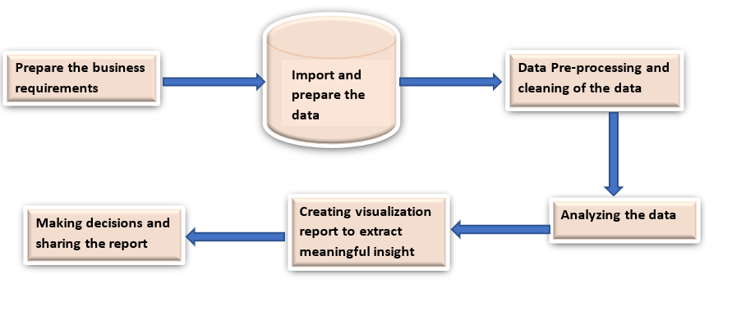
Architecture:

Slide 7
Data Cleaning and Transformation:
Null values in columns - If any of the columns in a file have all the values as NULL or missing, we discard such records.
Remove duplicates - Remove duplicate records if have any
Remove non-useful columns – Column like “Remarks” is not necessary so we can drop the column. Columns like “Remains of wildlife collected?” and “Remains of wildlife sent to Smithsonian” are not necessary for the study, we also can remove from our model.
Unwanted values in columns - Remove rows or replace with other values if any categorical values column contains some unknown or unwanted values. For one record column “Aircraft: Number of engines?” column contain a random letter instead of a digit, so we can remove that record.
Validate data type – Check data types of columns if necessary change the data type.
Tools used:
Most of the cleaning and transformation were done in Python and some of the transformations were done in Power BI Power query editor.

Slide 8
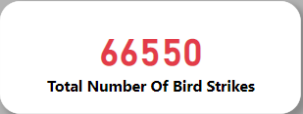
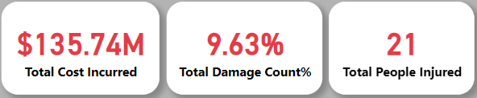
Some important KPIs
So, in total bird strike cases, only 9.63% of times damage happened due to bird strikes.

Slide 9
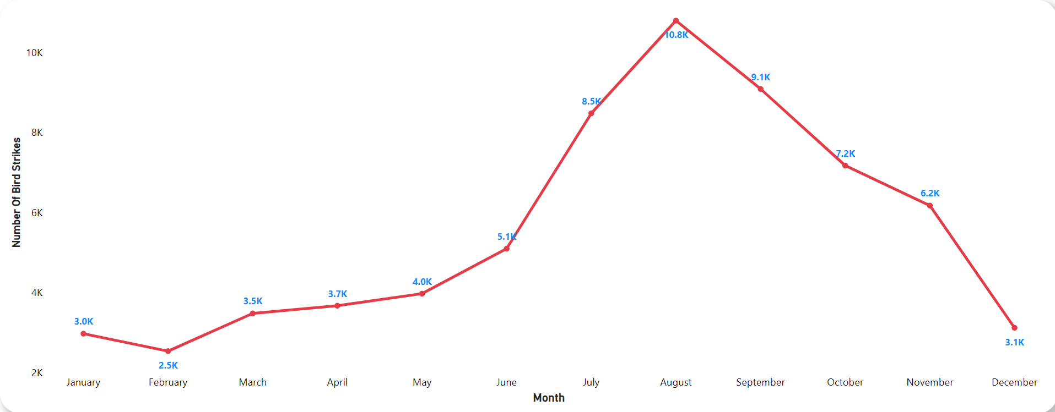
Number Of Bird Strikes by Month
In most of the year except some years in time from July to October, most bird strikes happened.

Slide 10
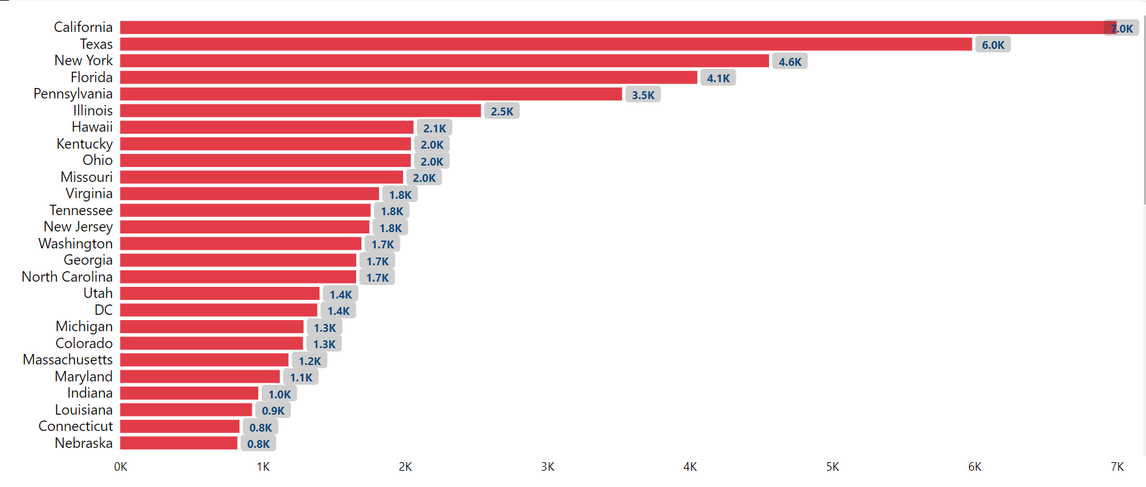
Top Origin States By Number Of Bird Strikes
The top 3 states where most bird strikes happen are California, Texas, and New York respectively.

Slide 11
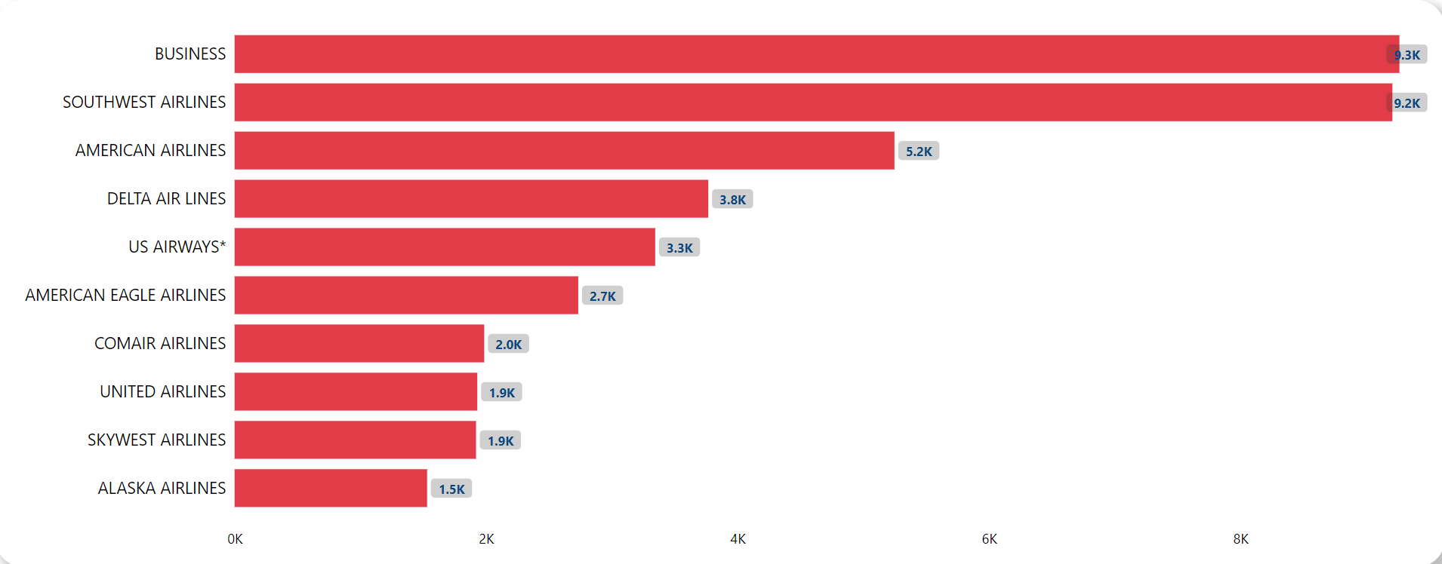
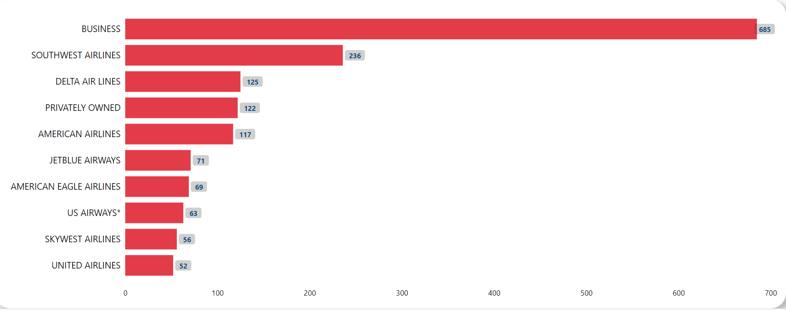
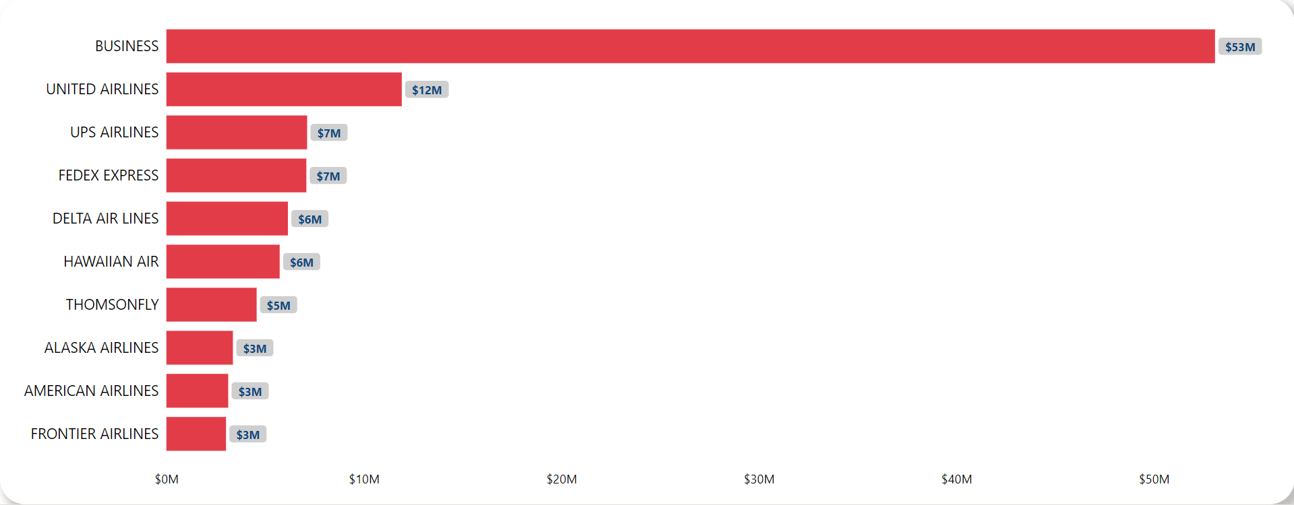
Top 10 Airlines By Number Of Bird Strikes
Airline Analysis
Top 10 Airlines which have most damage count due to Bird Strikes
Top 10 Airlines which generate most cost due to Bird Strikes
Business Airlines and Southwest Airlines caused more Bird Strikes and also top in total damage count. Whereas most repair costs are incurred by Business Airlines and then United Airlines.

Slide 12
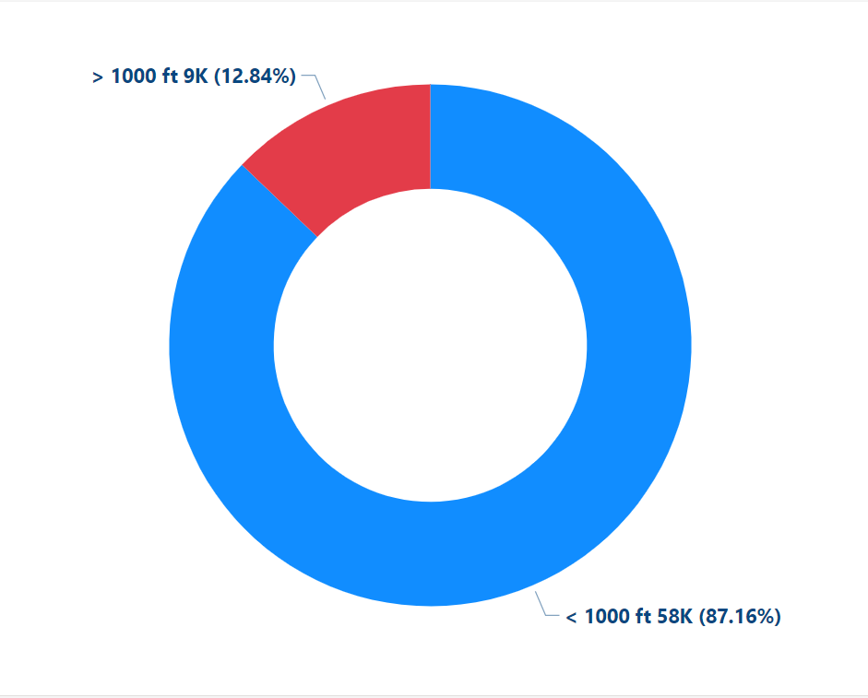
Altitude bin analysis
87.16% of the total number of bird strikes happened at the altitude <1000 ft.

Slide 13
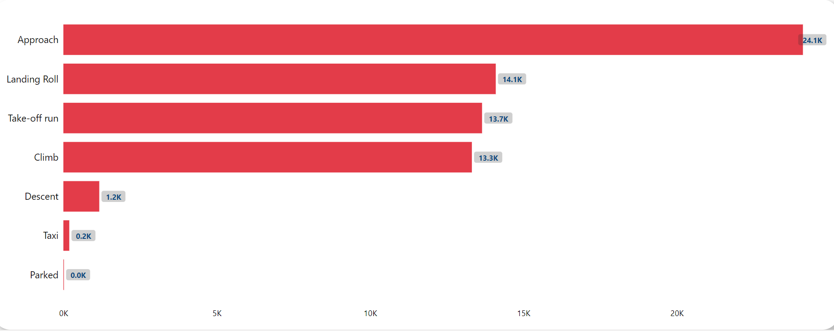
Phase of the flight analysis
Most of the bird strikes happen during the Approach, Landing roll, Take-off run, and Climb flight phases respectively.

Slide 14
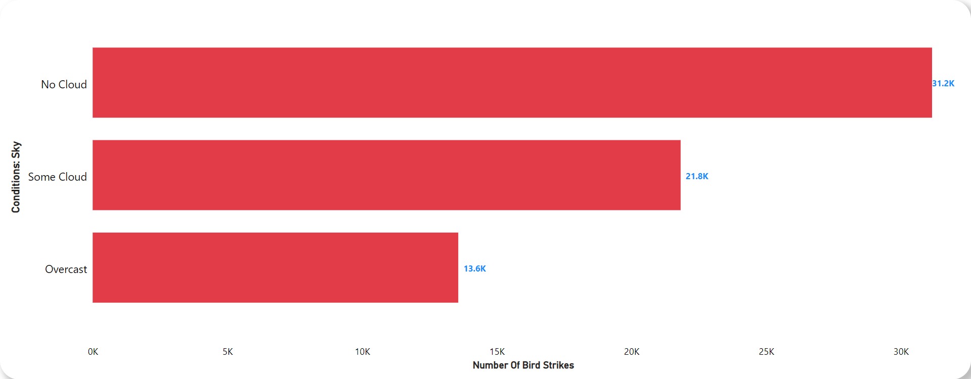
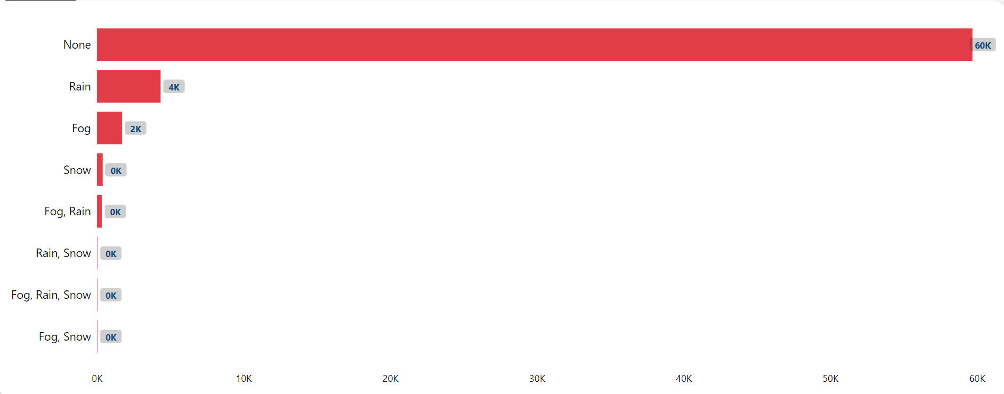
Sky Condition and Precipitation analysis
Sky Condition Vs Number Of Bird Strikes
Most of the Bird Strikes happened with no clouds.
Precipitation By Number Of Bird Strikes
Precipitation does not affect that much in Bird Strikes.

Slide 15
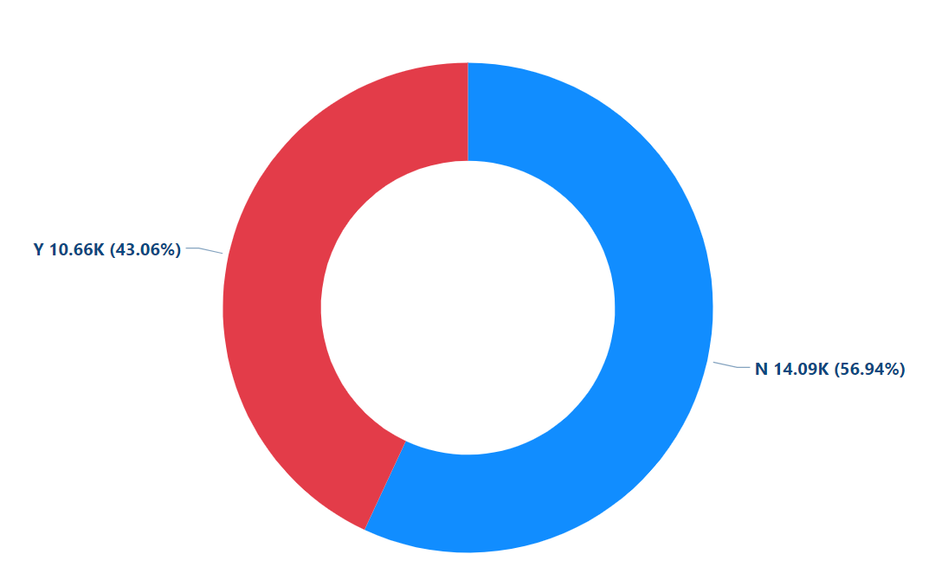
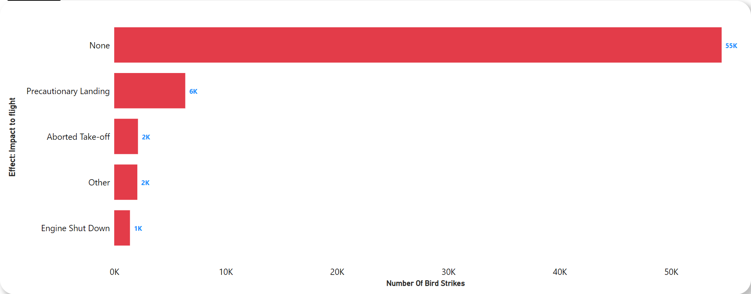
Impacts on flight and prior warning
Are Pilots Informed? Vs Number Of Bird Strikes
43.06% of the time pilots were informed about wildlife.
Impact On Flight Vs Number Of Bird Strikes
In most cases, there are no impacts in flight due to Bird Strikes. In some cases, precautionary landing and others impacts were observed.

Slide 16
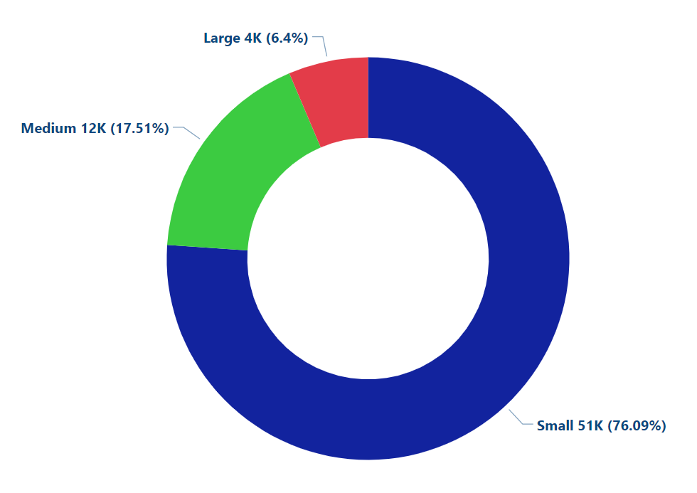
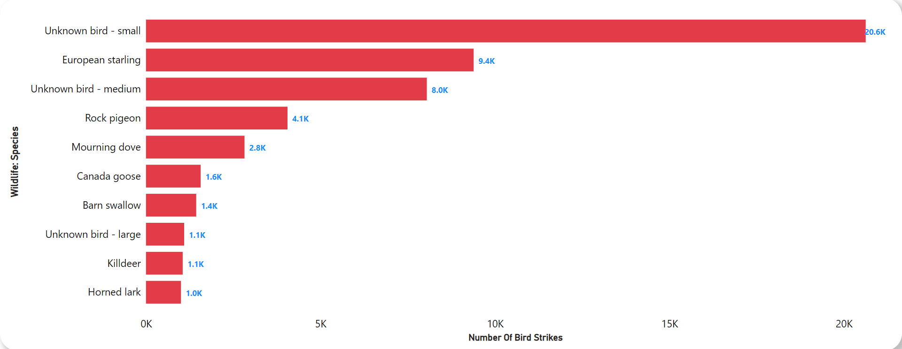
Wildlife analysis
Wildlife Size Vs Number Of Bird Strikes
Most of the Bird Strikes happened with small size wildlife. Most of the species which caused strikes are the unknown small birds, European Starlings, and Unknown medium birds respectively.
Top 10 Wildlife Species According Number Of Bird Strikes

Slide 17
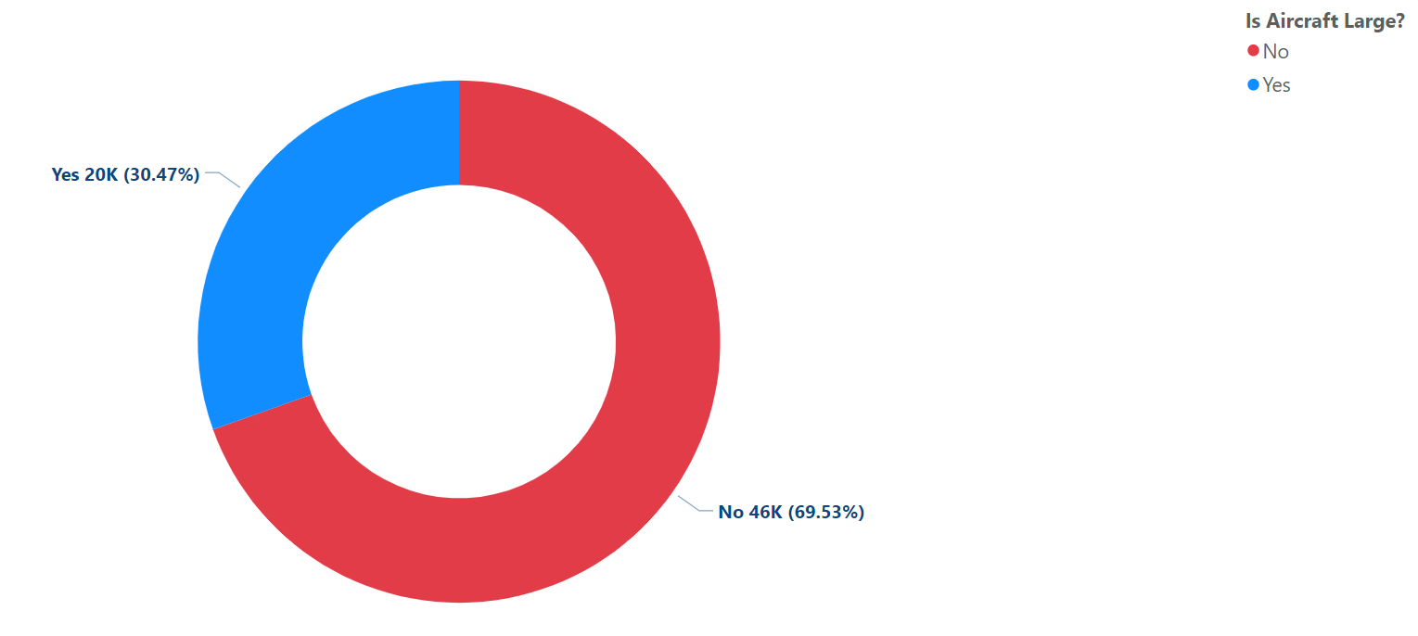
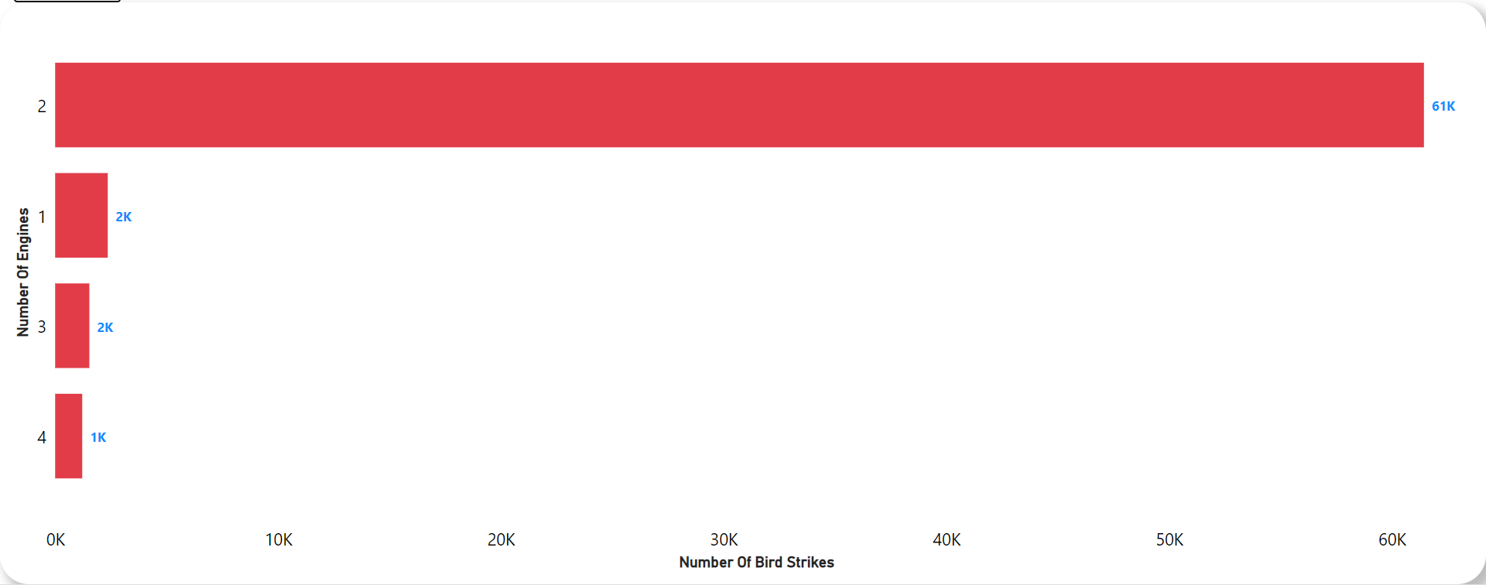
Aircraft analysis
Aircraft Size Vs Number Of Bird Strikes
69.53% Aircraft size is not large. Most of cases bird strikes happened with 2-engine aircraft.
Number Of Engines Vs Number Of Bird Strikes

Slide 18
Important Links
For Full Project Report Click The Link:
https://www.novypro.com/project/transportation-and-communication
For Github Repository Click The Link: https://github.com/mdsahilmca20/PortfolioProjects/tree/main/Bird%20Strike%20Rate
For Video Presentation Click The Link:
https://youtu.be/_GhEqCaIv6Y
For Linkedin Post Click The Link:
https://www.linkedin.com/posts/md-sahil-dataanalyst_internship-ineuron-dataanalytics-activity-7055138417000497152-MXYg?utm_source=share&utm_medium=member_desktop

Slide 19


